Slide 1
Bargain Hunter Connecting travelers with spare rooms and swapping goods effortlessly
Team 2

Slide 2



Team 2
BH
Jinit Dipesh Desai (Project Manager)
Shiva Sourav Kasula(Project Owner)
Amir Zakik (Business Analyst)
Huzefa Sadikot(Lead Developer)
Niyati Trivedi(Developer)
Yakshita Rakholiya( Lead DBA)
Fnu Pariva (QA Analyst)
Bansariben Sorathiya(Software Tester)

Slide 3
Team 2
BH
Alsten Vaz (Project Manager)
Anil Kumble Bethapudi(Project Owner)
Pankti Alpesh Desai (Business Analyst)
Jayesh Lad(Lead Developer)
Anudeep Reddy Suram(Developer)
Venkata Sai Kunduru( Lead DBA)
Chinmay Deshpande(QA Analyst)
Vatsalkumar Balar(Software Tester)

Slide 4

Contents
GitHub Repository
Jenkins Pipeline Deployment Source Code

Slide 5
GitHub URL:
https://github.com/Hsadikot95S/Bargain-Hunter

Slide 6
GitHub Repository Structure

Slide 7
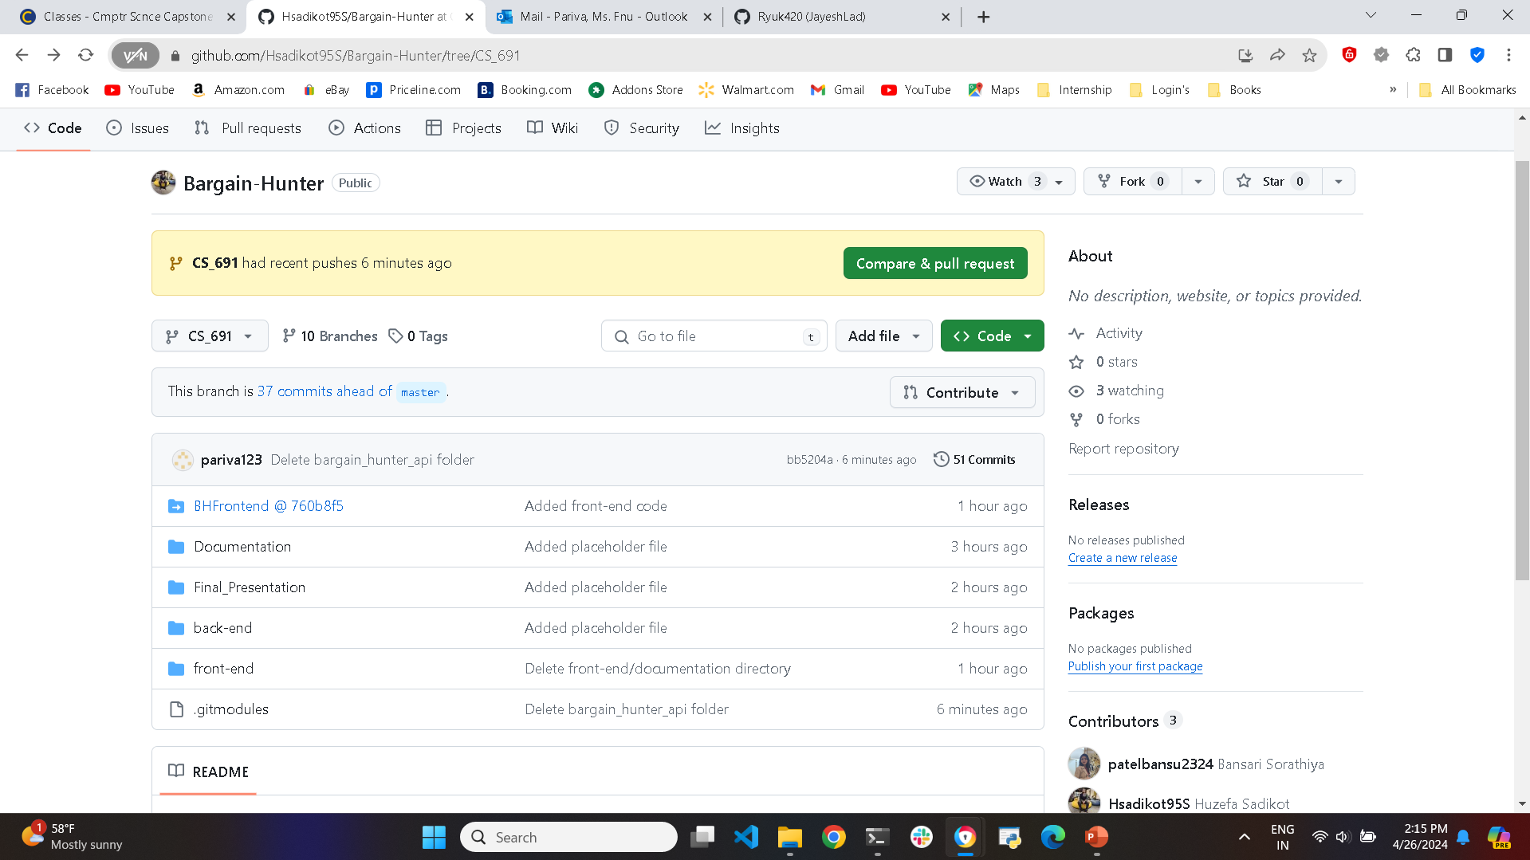
Repository Structure

Slide 8
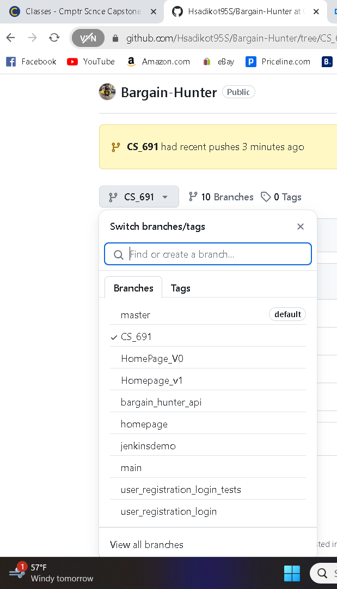
Repository Structure(All Branches)

Slide 9
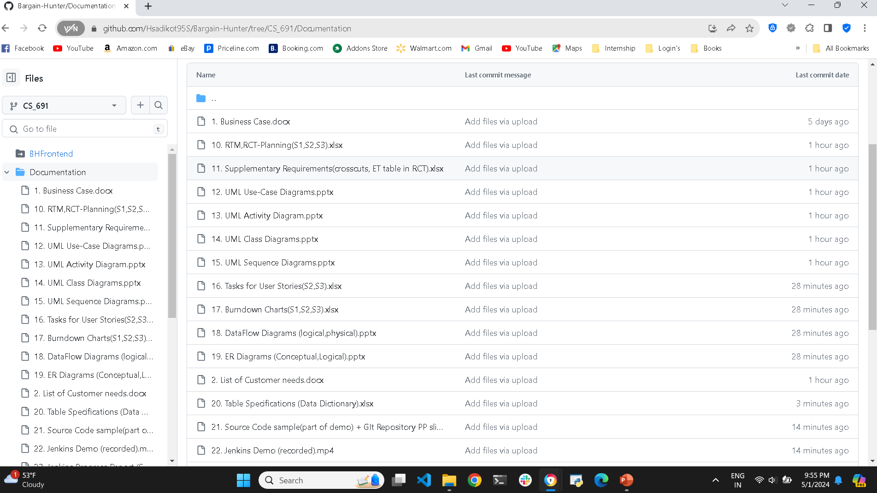
Repository Structure(All the Documents)

Slide 10
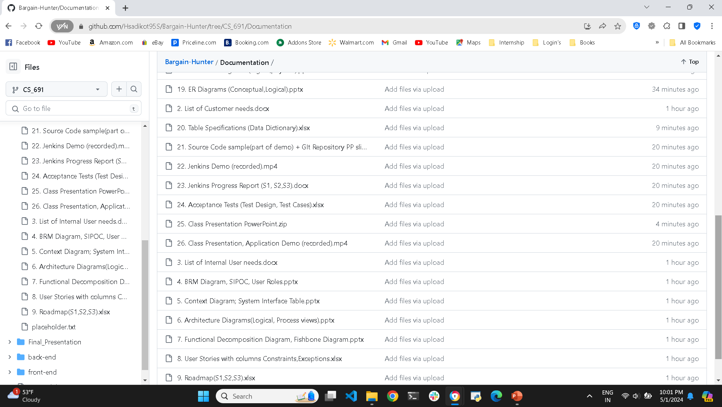
Repository Structure(All the Documents)

Slide 11
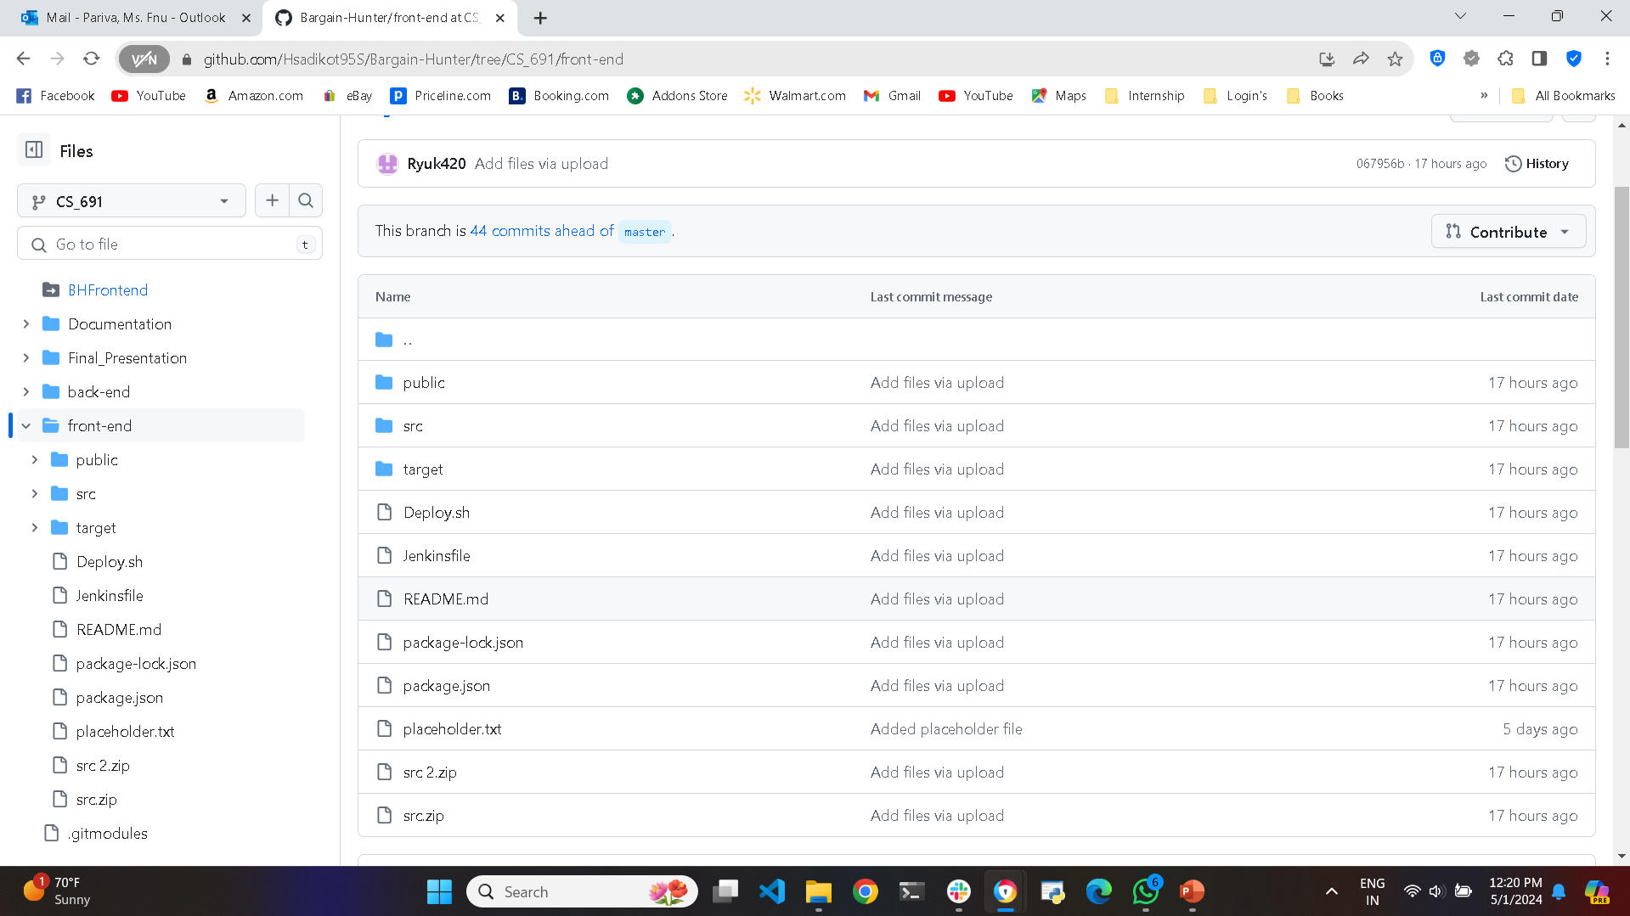
Repository Structure(Front-End)

Slide 12
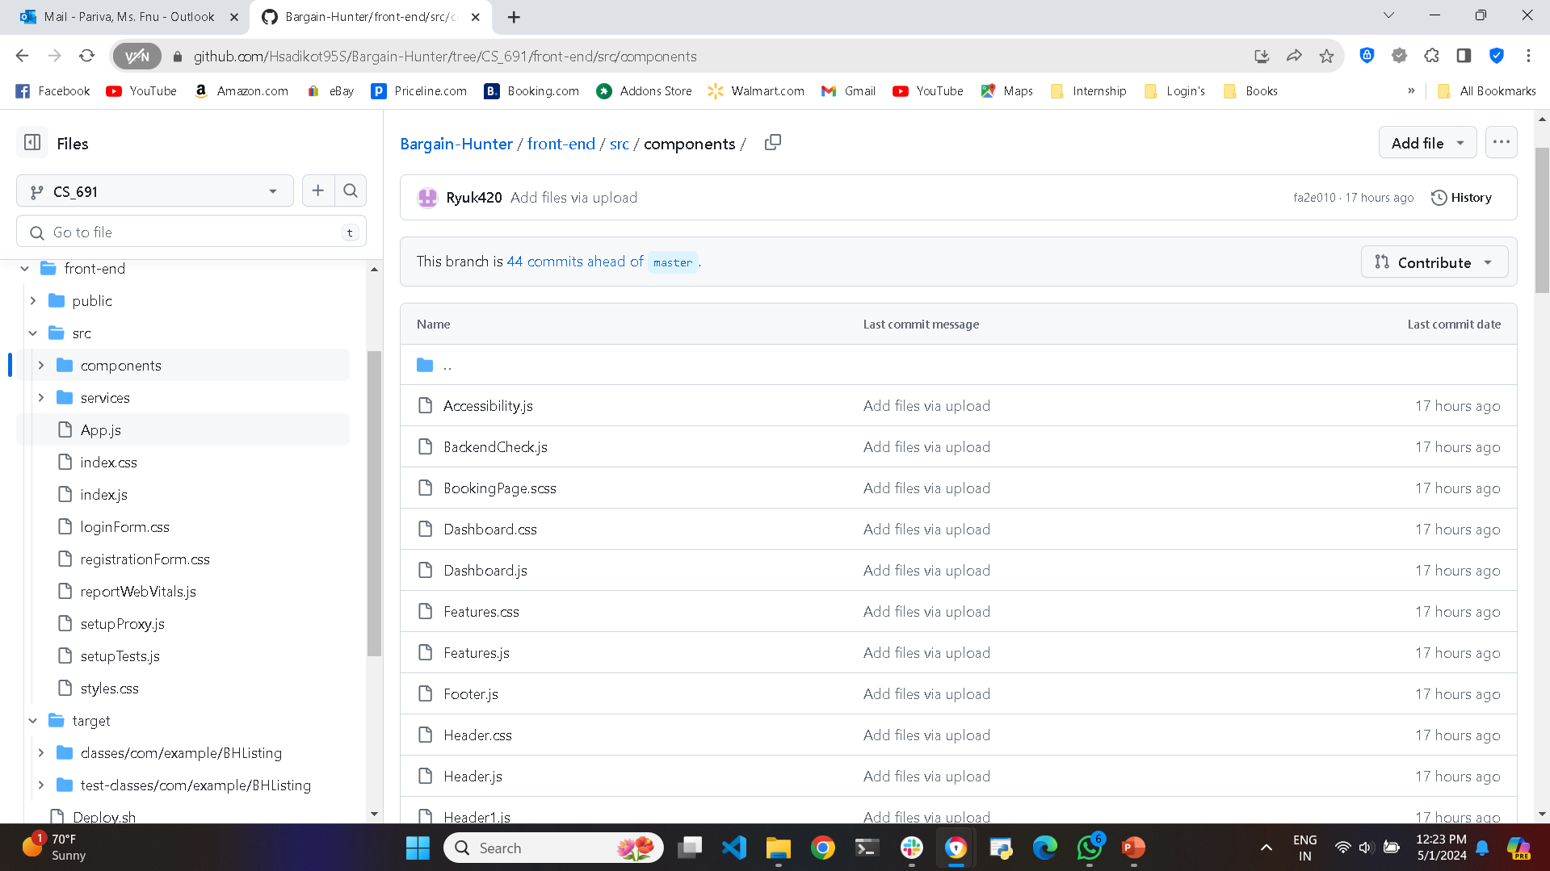
Repository Structure(Front-End- Source Code)

Slide 13
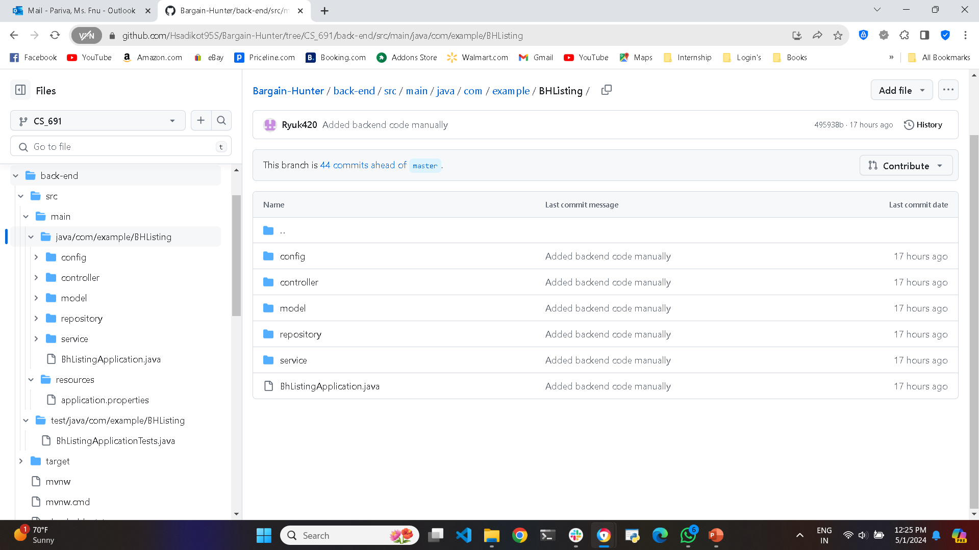
Repository Structure(Back-End)

Slide 14
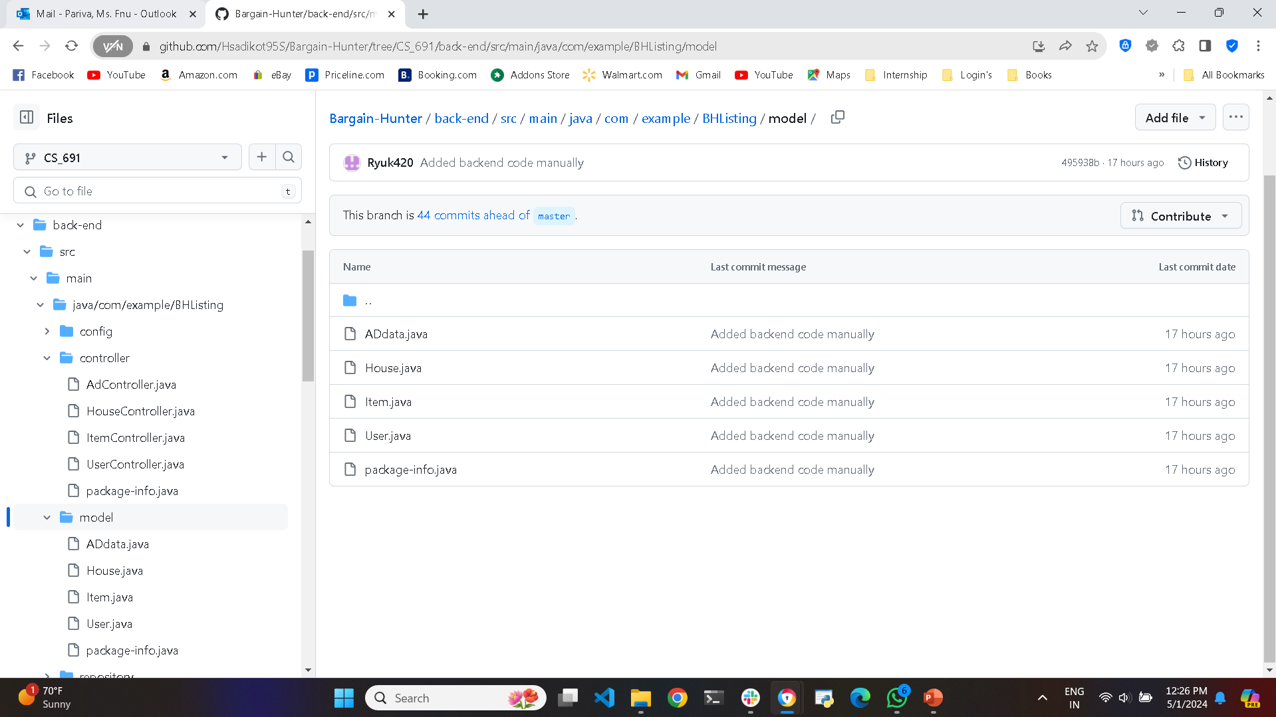
Repository Structure(Back-End- Source Code)

Slide 15
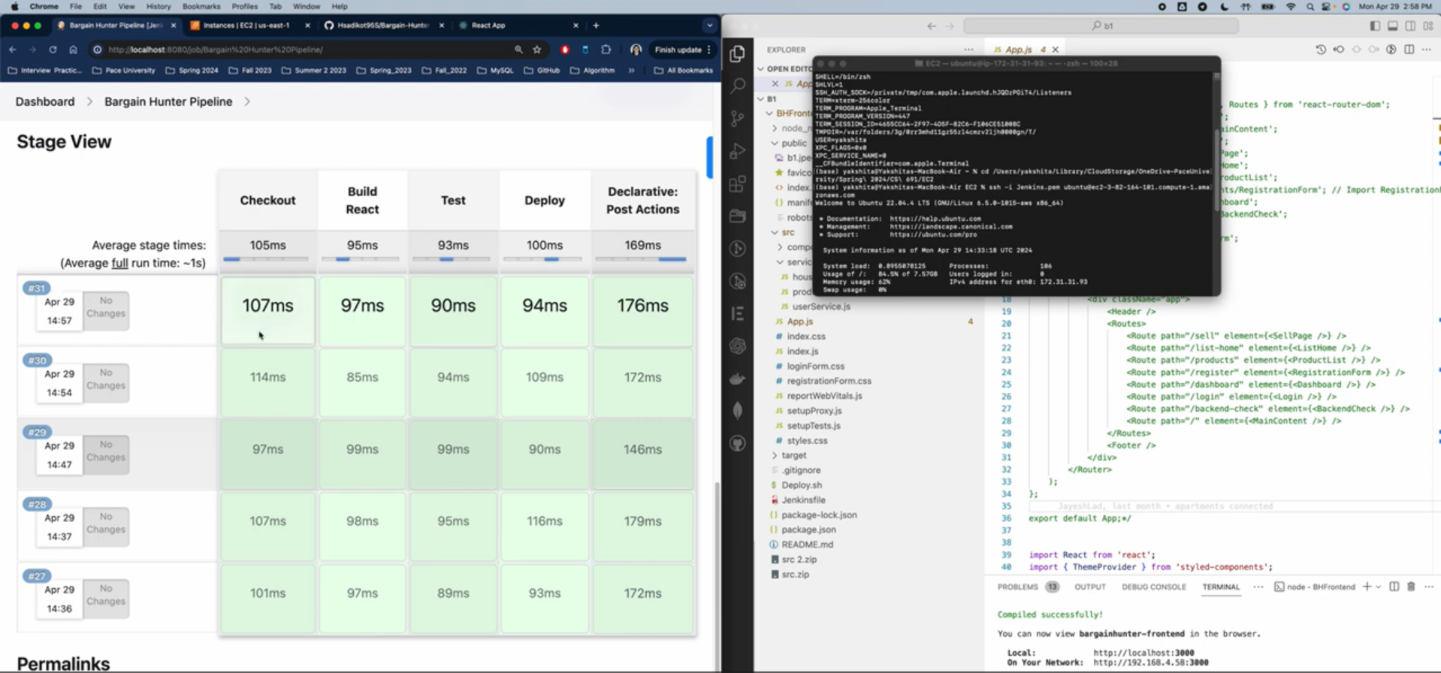
Jenkins Pipeline Deployment

Slide 16
Build and Deployment Procedures
BH

Slide 17
Prerequisites:
React.js ( Front end)
Java (Back end )
Spring boot (Back end)
MongoDB (Database)
These all must be installed in your local machine

Slide 18
Financial Transaction Management
Three Core Features must be intertwined:
Manage payment methods
Process returns and refunds
Ensure security and fraud prevention measures

Slide 19
Advertising Management
One Core Features must be intertwined:
Post more ads by premium users

Slide 20
Source Code

Slide 21
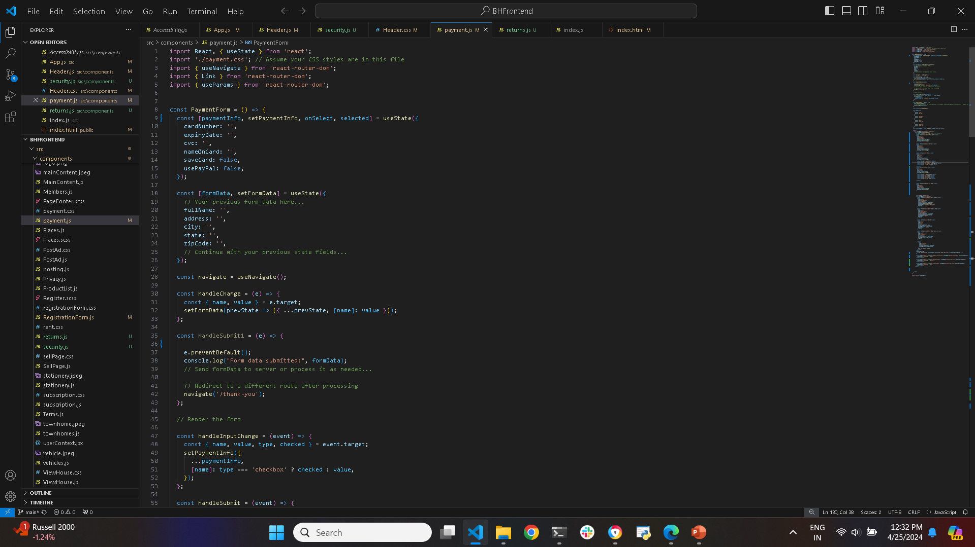
Core Features: Manage Payment Methods

Slide 22
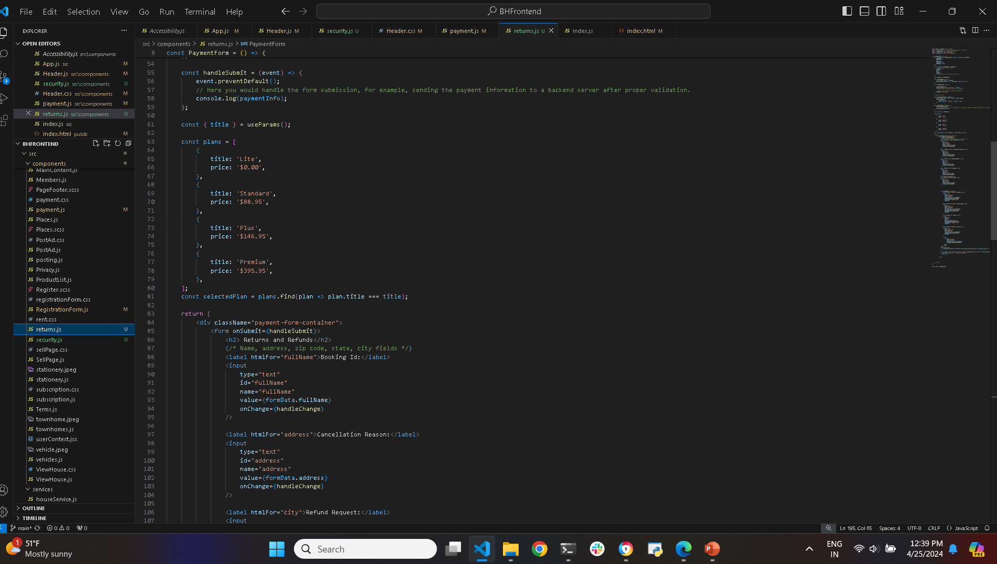
Core Features: Process Returns and refunds

Slide 23
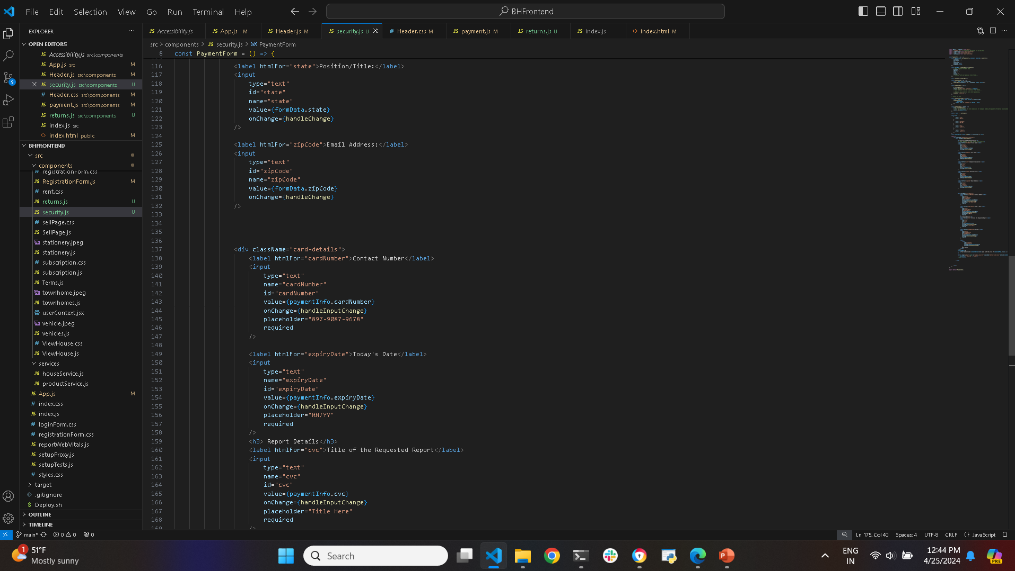
Core Features: Ensure Security and fraud prevention measures

Slide 24
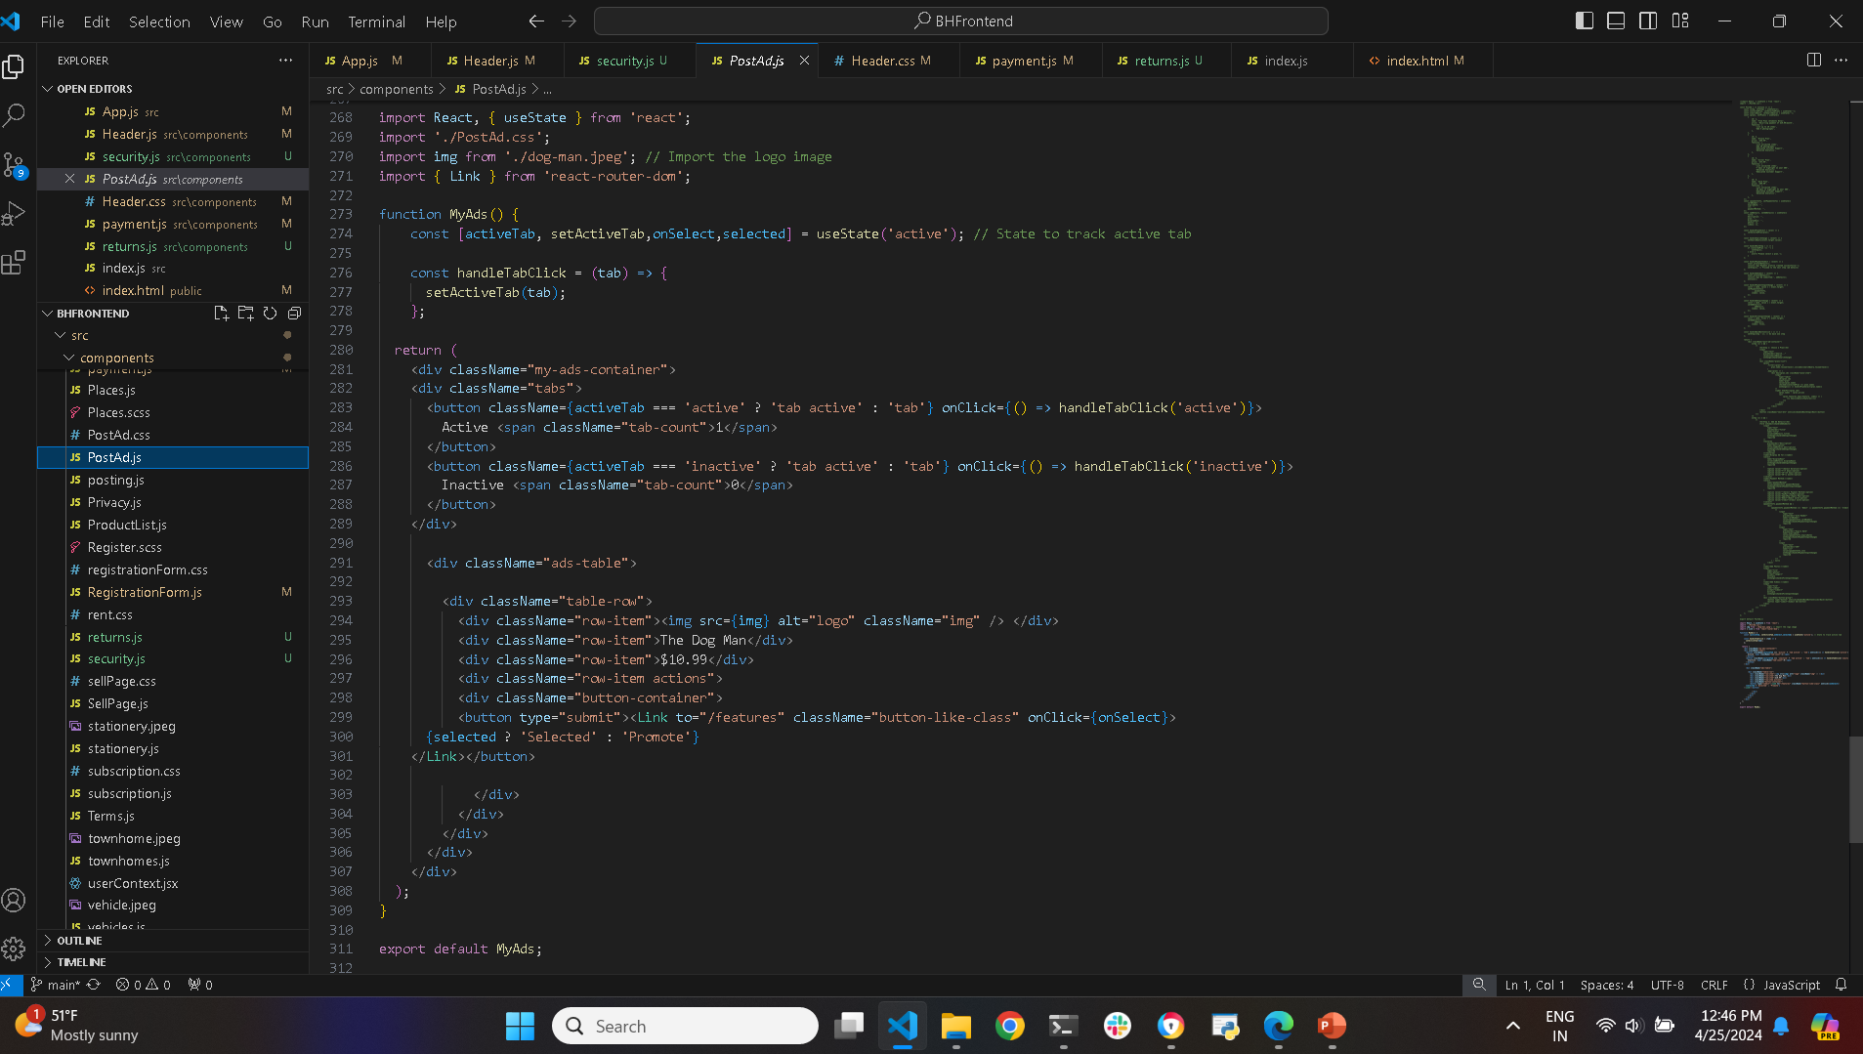
Core Features: Post ads by premium users

Slide 25
Thank you
Appreciation blooms in every slide, Thanks for watching!❤️💕

